Slide 1
MEASUREMENTS
TRUE VALUE
WEIGHT
No. SAMPLES

Slide 2


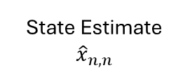



MEASURE
Output
Initialize
Input:
Measure value
State Estimate
$${\hat{x}}_{n,n}$$
Input:
System State Initial Guess
$$z_{n}$$
MEASURE
MEASURE
Unit Delay
Calculate the Kalman Gain
Estimate the current state using the State Update Equation
Calculate the predicted state for the next iteration using System’s Dynamic Model
$$n→n−1$$
$${\hat{x}}_{n,n}$$
$${\hat{x}}_{n+1,n}$$
$${\hat{x}}_{n,n−1}$$

